Slide 1

Kunal Bharadwaj
Veera Vignesh

Slide 2

CONTENTS
1
Introduction
2
Problem Statement
3
Data Analysis & Insights
4
Conclusion

Slide 3
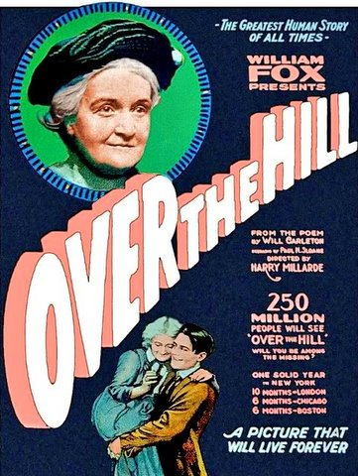




INTRODUCTION
1977-1999
Appearance of Blockbusters
(1103)
1927-1940
Talkies and the rise of the Hollywood studios
(23)
2000s
Modern film industry
(3503)
1941-1976
Golden Era of Film and restructuring of Hollywood
(181)
1911-1926
The Silent Era
(3)

Slide 4
PROBLEM STATEMENT
1
Business Problem
2
Hypothesis

Slide 5
PROBLEM STATEMENT
1
Business Problem
What factors should we consider to make a successful movie?

Slide 6
BUSINESS PROBLEM
2
Hypothesis
Higher the budget? Higher is the Gross?
Best genre to make successful movie in the current era?
Common plots of successful movies?

Slide 7
ABOUT DATA
Data Source – data.world
(IMDB-5000-Movie-Dataset )
Rows x Columns – 5048 x 28
100 years of data , 66 Countries

Slide 8
DATA ASSUMPTIONS
Box office collection is only for US market for worldwide movies
Genre 1 is considered as the primary genre of the movie
Dataset is a sample of the 5000 movies released during the period 1916 - 2016

Slide 9
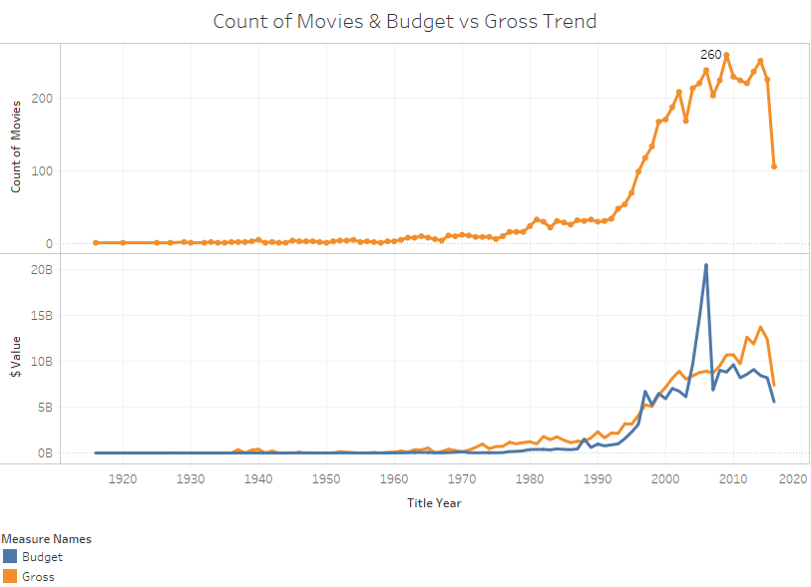
DATA ANALYSIS & INSIGHTS
Industry Trend
Golden Era

Slide 10
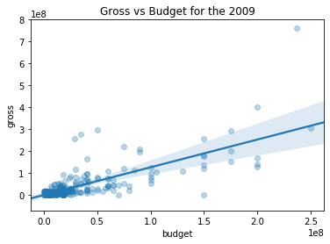
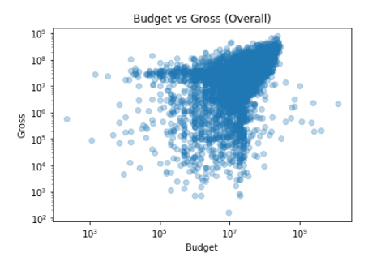
DATA ANALYSIS & INSIGHTS
Higher the budget? Higher is the Gross?
Budget vs Gross for the year where the number of movies produced where maximum
Budget vs Gross for All the observations

Slide 11
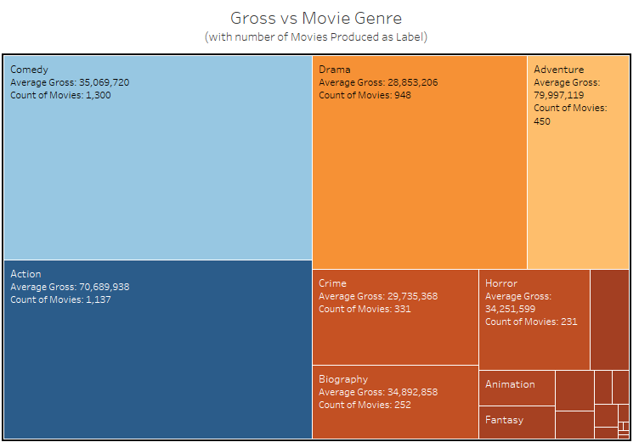
DATA ANALYSIS & INSIGHTS
Best genre to make successful movie in the current era?
Adventure and Animation has about $ 80 M USD even though the number of movies produced in Animation is less

Slide 12
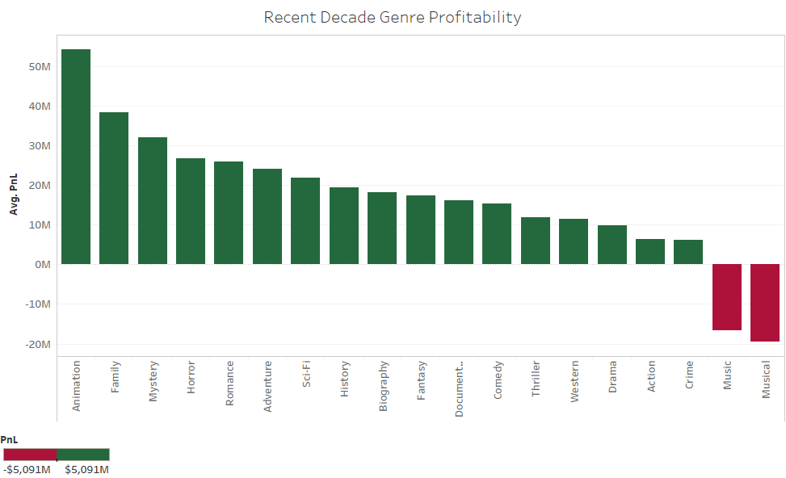
DATA ANALYSIS & INSIGHTS
Best genre to make successful movie in the current era?
Based on the recent Decades Trend we can choose Animation and Family for the best profitability. And also the number of movies produced in this genre is less.

Slide 13
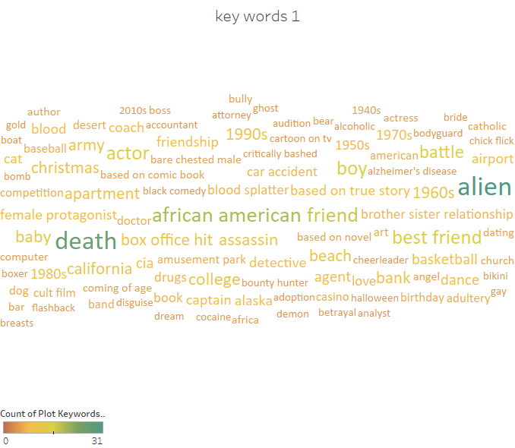
DATA ANALYSIS & INSIGHTS
Common plots of successful movies?
Based on the word cloud extracting the number of words that occur frequently in Animation and Family to make a plot out of it.
Movie Dashboard

Slide 14
DATA ANALYSIS & INSIGHTS
Common plots of successful movies?
Family - bicycle, boy, doll, voice impersonation
Animation -food, dance, boy, dog, minion
Movies can be made on these plot keywords which will increase the likeability and profitability of the movie

Slide 15
CONCLUSION
Based on the past data we have a linear relation between the budget and gross
Movie primary genre should be Animation or Family for maximum gross based on past decade trend
Story plots in these genre should have
Animation – food, dance, boy, dog, minion
Family – bicycle, boy, doll, voice impersonation

